Slide 1
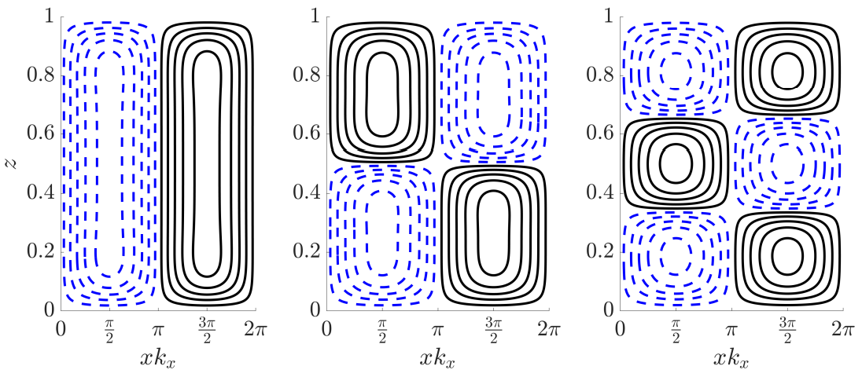
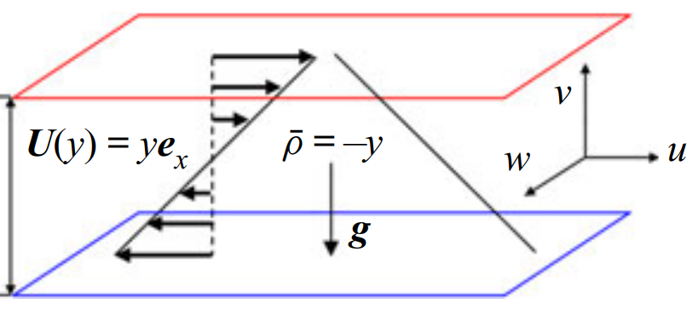
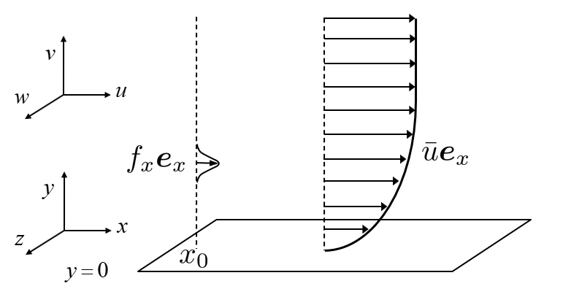
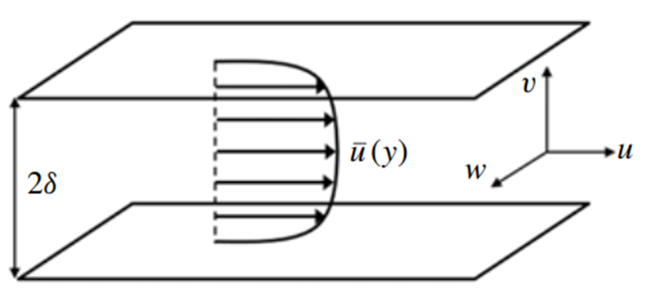
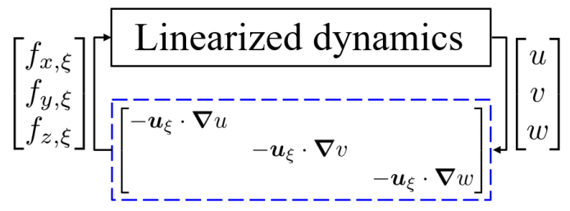
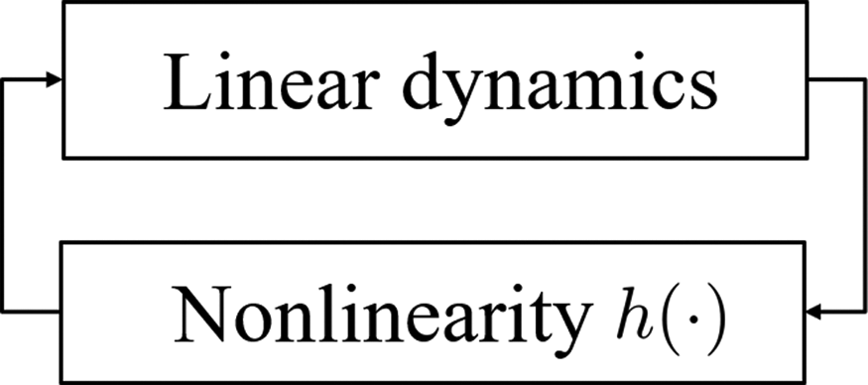
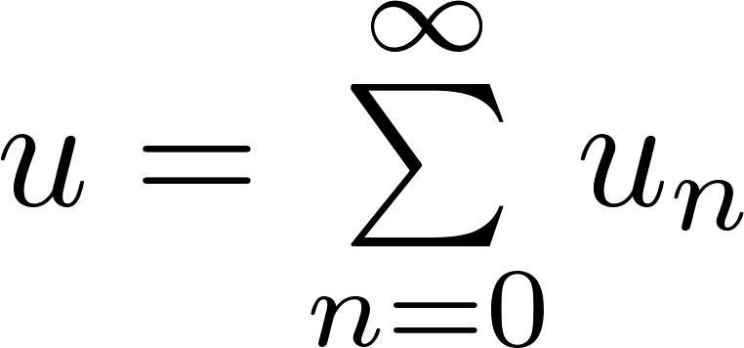
Research summary
Flow configuration complexity
Salt-finger convection
Stratified shear flows
Full equations
Actuated turbulent boundary layers
Wall-bounded
shear flows
Low-dimensional models
Spatial I/O
I/O
Convex
optimization
Asymptotic analysis
Bifurcation
Linear
Structured I/O
Nonlinear
I/O: input-output analysis
Notes:
Here, I will use this figure to summarize my previous research. The horizontal axis measure different level of nonlinearity that was included in different reduced order models. The vertical axis measure different level of flow configuration complexity. One direction of my previous work is developing reduced order models by including nonlinearity systematically building upon linear analysis. Another direction is performing dimension reduction starting from full equations, as shown from right to left. In addition to what I have discussed as highlighted here, I also analyzed some other flows include actuated turbulent boundary layers and turbulent channel flows. I also developed an analysis framework based on convex optimization, that can include more information of nonlinearity, although getting more computational expensive. I also use asymptotic analysis to analyze some other low-dimensional models include shallow-water waves.

